Slide 1
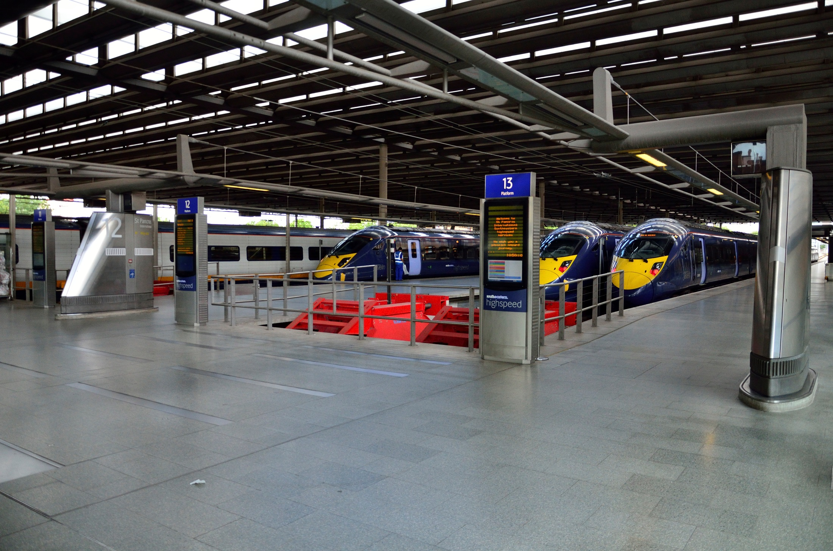
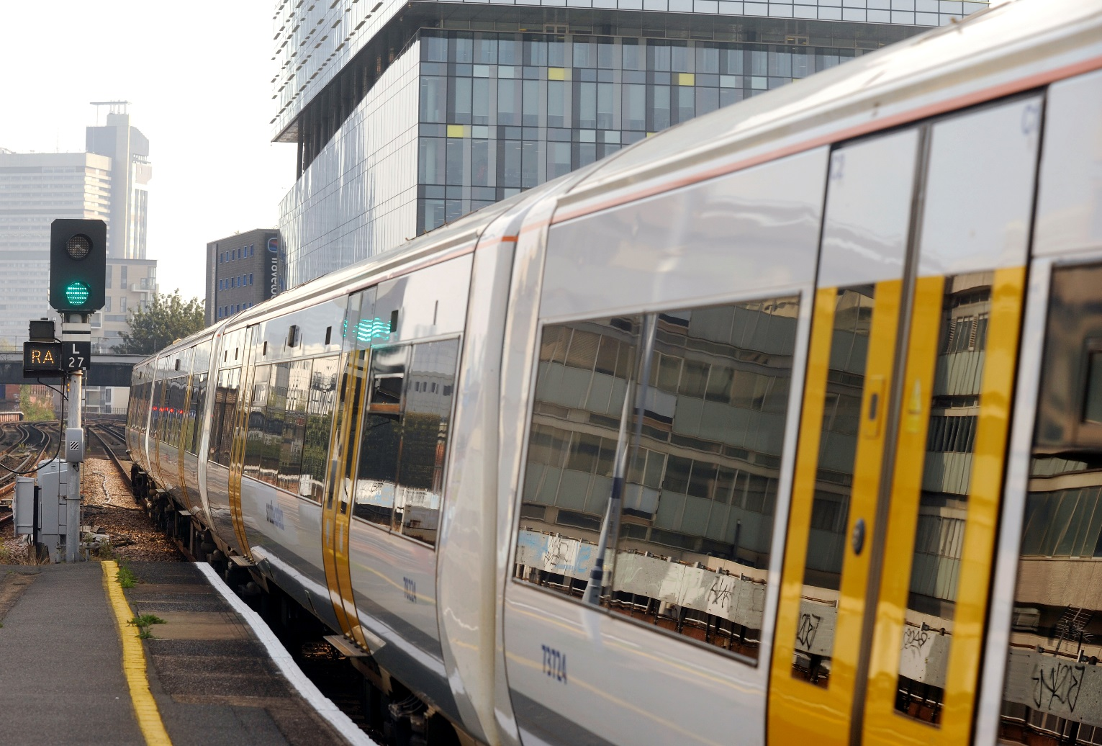
Competition for a new South Eastern Franchise
Jane Cornthwaite, Markets Director

Slide 2
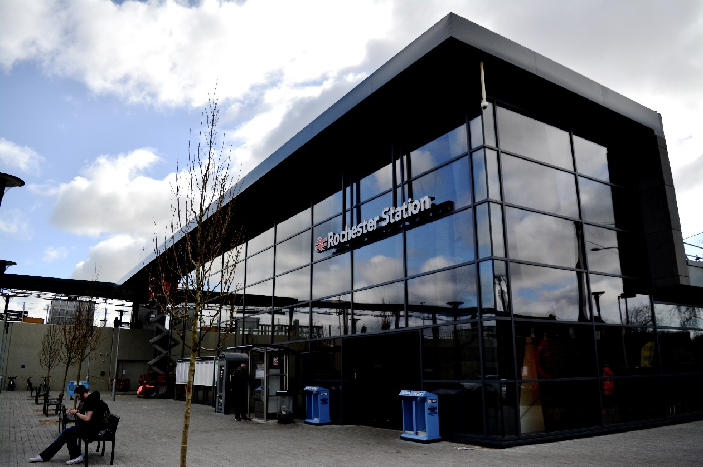

Video presentation

Slide 3
South Eastern Route Network
London termini
HS1
Metro services
Kent coastal
loop
Longer distance mainline services
East Sussex

Slide 4

Satisfaction and Passenger Priorities
Overall passenger satisfaction with their journey at 75%
‘Commuting’ passenger satisfaction at 68%
High speed passenger satisfaction at 93%
South Eastern passengers’ top priorities for improvement
value for money for price of ticket
punctuality/reliability of the train
frequency of trains on the route
being able to get a seat on the train
length of time the journey was scheduled to take.
Source: Transport Focus, Autumn 2015
Source: Transport Focus 2012 consultation in advance of Direct Award, 2014 - 2018

Slide 5
Revenue and Growth
Source: ORR Data Portal
Source: TOC Management Accounts

Slide 6
Priorities and Opportunities for the South Eastern Franchise
Improved capacity
Better passenger experience
Sustainability
More journey opportunities
Working with partners
Innovation

Slide 7
Timeline and next steps
Nov 2016
Issue EOI
April 2017
Issue ITT
Feb 2018
Contract Award
June 2018
Franchise Start
01/08/16
Passport Application
Stakeholder Engagement
Bidder Day
Prospectus launch alongside EOI
Bidder Engagement

Slide 8
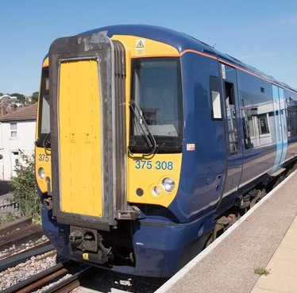
Further information
Speak to us today
Email the team at SouthEasternFranchise@dft.gsi.gov.uk

